Slide 1


Stores Sales Forecasting
Done by:
Hamza Naser
Diaa Alqadi
Dana Ghazal

Slide 2
Outline
1) Introduction
- Problem Definition
- Dataset
2) Approach
- Model Selection
- Hyperparameter tuning
- SARIMA
3) Model Deployment
- Website
4) Conclusion & Future Work

Slide 3
Introduction

Slide 4
Problem Definition
Project objective: Enhance sales performance and drive growth in a competitive retail landscape.
Sales improvement goals: Achieve a 10% increase in weekly sales over the next 3 months, through strategic expansion and improved customer engagement.
Machine learning forecasting: Utilize machine learning algorithms to predict weekly sales using Walmart's historical sales data for 45 stores from February 2010 to October 2012.
Key benefits: Accurate sales predictions, optimized inventory management, and data-driven decision-making for increased profitability.

Slide 5
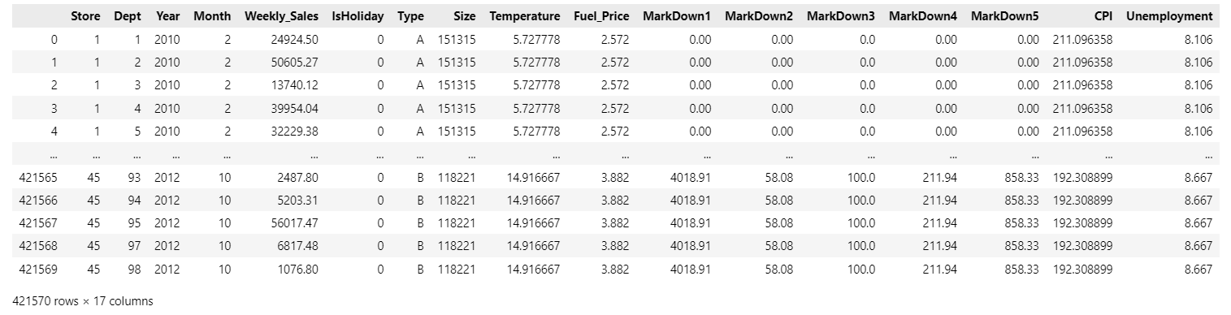
Dataset
The final merged and preprocessed dataset includes various features.

Slide 6
Approach

Slide 7
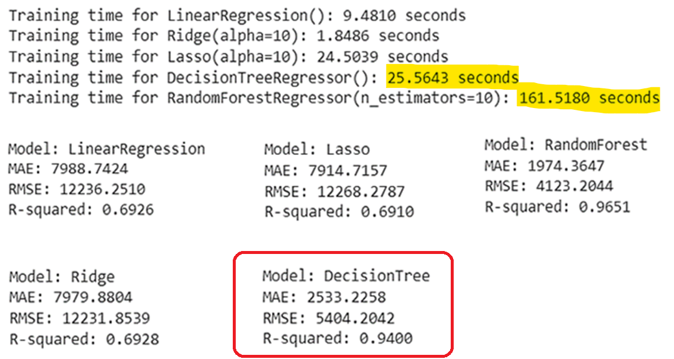
Model Selection
Train test split: test split was determined based on last 7 months of sales, 21% of the data.
We prepared the data by performing one-hot encoding on categorical columns and scaling the numerical features.

Slide 8
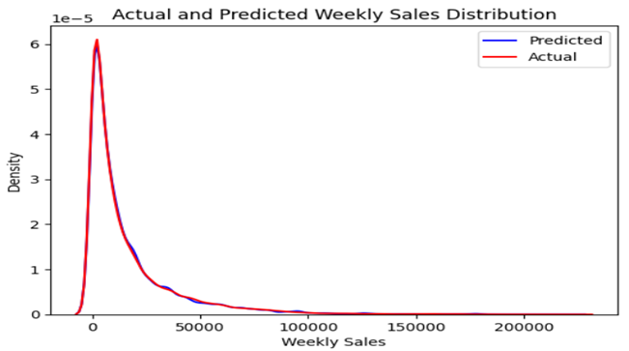
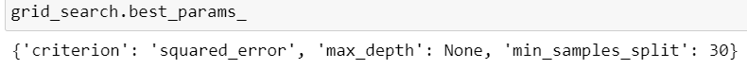
Hyperparameter tuning
We enhanced the Decision Tree Regressor's performance by tuning hyperparameters with GridSearchCV and converting categorical features to numeric using OrdinalEncoder.
R-squared: 94.2% in the test data, and visualized by KDE plot.

Slide 9
Time Series Forecasting
Time series forecasting is a technique for the prediction of events through a sequence of time. It predicts future events by analyzing the trends of the past, on the assumption that future trends will hold similar to historical trends.

Slide 10
ARIMA vs. SARIMA
ARIMA (Auto Regressive Integrated Moving Average)
Purpose: ARIMA is used for time series forecasting, capturing non-seasonal patterns.
Components: It consists of autoregressive (AR) and moving average (MA) components, along with differencing for stationarity.
Advantages:
- Effective for non-seasonal data.
- Simplicity and ease of use.
Limitations:
- Not suitable for data with clear seasonality.
- Assumes stationary data.

Slide 11
ARIMA vs. SARIMA
SARIMA (Seasonal Auto Regressive Integrated Moving Average)
Purpose: SARIMA extends ARIMA to capture both non-seasonal and seasonal patterns in time series data.
Components: SARIMA includes seasonal AR, seasonal differencing, and seasonal MA components, in addition to non-seasonal ones.
Advantages:
- Suitable for data with strong seasonal patterns.
- Enhanced forecasting accuracy.
Limitations:
- More complex than ARIMA.
- Requires identification of seasonal patterns.

Slide 12
Time Series Forecasting with SARIMA
The ‘forecast’ function is a tool for time series forecasting, specifically tailored to predict weekly sales data for a designated store.

Slide 13
Time Series Forecasting with SARIMA
Key Steps:
Data is filtered to isolate information pertinent to the chosen store.
Mean weekly sales are computed through date-based grouping.
The dataset is partitioned into training and test sets.
SARIMA model parameters are specified, and the model is trained on the training data.
Forecasts are generated for a predefined future period.

Slide 14
Time Series Forecasting with SARIMA
Forecasted values are refined based on the specified month and year.
In cases with no forecasted values, observed data from the training set is employed.
The mean weekly sales for the selected month and year are calculated and displayed.
The R-squared score, indicating the model's goodness of fit, is presented.
A visual representation illustrates the observed and forecasted sales data.

Slide 15
Time Series Forecasting with SARIMA
Bias Detection:
Bias is evaluated by quantifying forecast errors and subjecting them to a hypothesis test for statistical significance.
A bias near zero signifies that the model's forecasts are, on average, accurate.

Slide 16
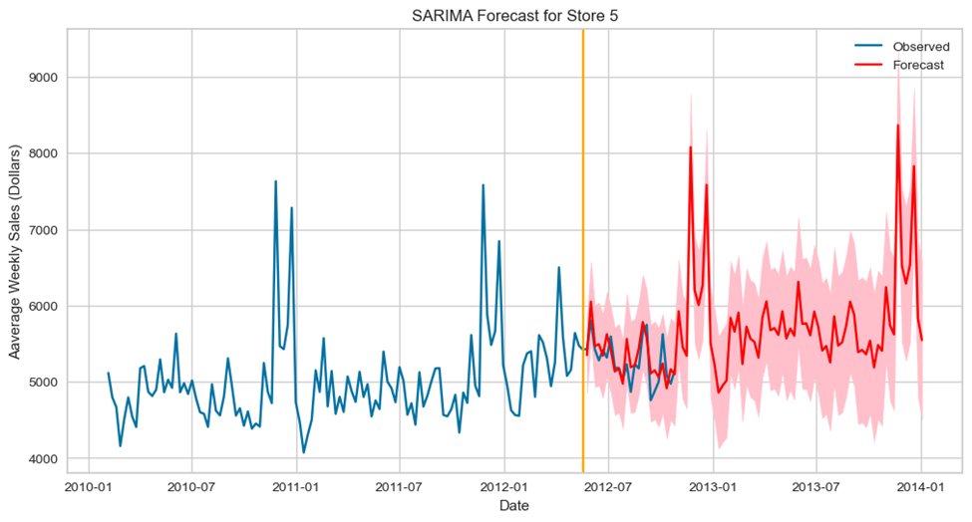
Running An Example
Forecasting weekly sales for store 5 until the end of 2013 and finding the average weekly sales for January,2013:

Slide 17
Model Deployment

Slide 18
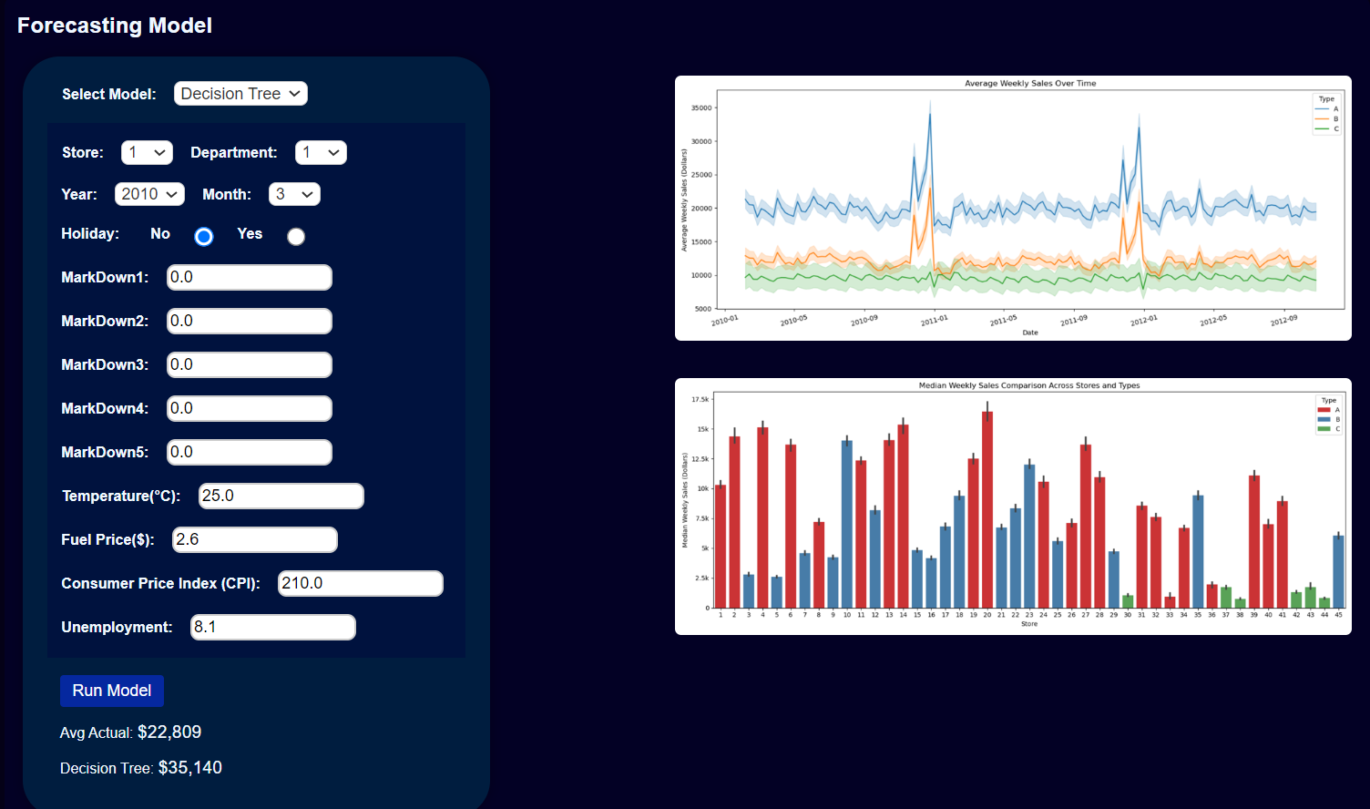
Web-app
HTML, CSS, JS
Python
Flask app
Cloud server (link)

Slide 19
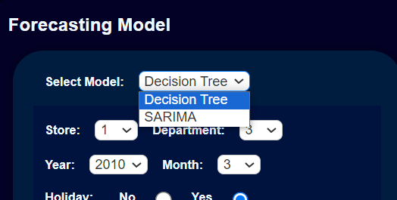
Models
Decision Tree
SARIMA

Slide 20
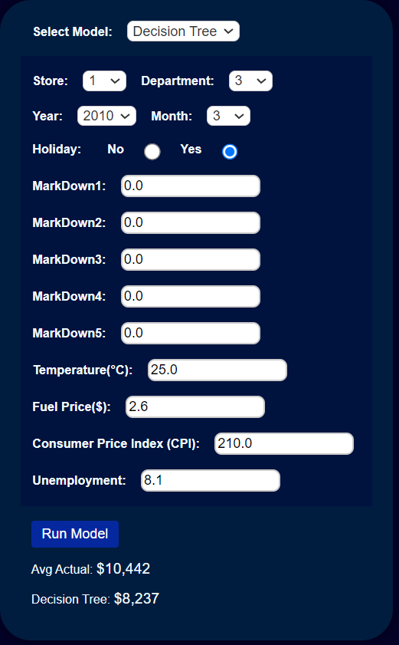
Decision Tree
Machine Learning Model.
Result affected by several features.

Slide 21
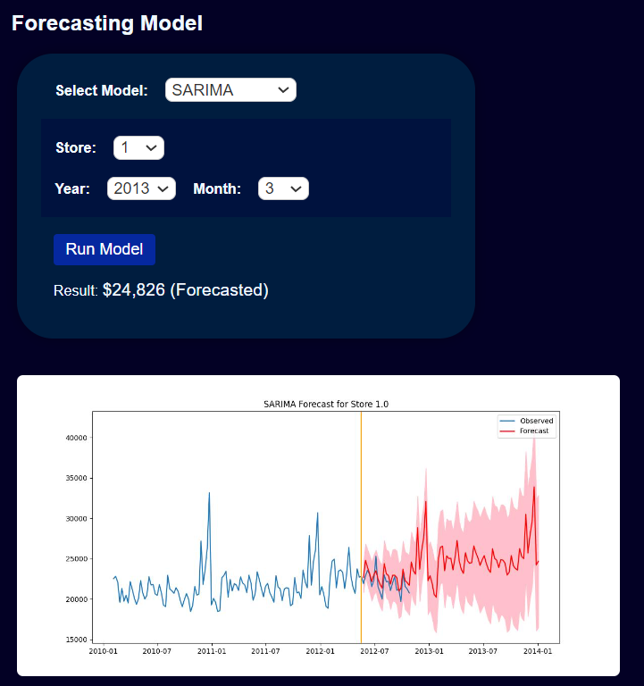
SARIMA
Time Series Model.
Results affected by date and sales pattern.

Slide 22
Challenges
Web development Knowledge.
Web Server not working on the cloud:
Disk Space
(Libraries and Frameworks) Versions Mismatch.

Slide 23
Conclusion & Future Work

Slide 24
Conclusion
Project outcome (Website).
Better Expansion decisions based on forecasted sales.
Better Sales prediction based on Economics, Climate Change and Seasonality.

Slide 25
Future Improvement
Consider to use other Forecasting model techniques (STL, Holt-winters, Exponential Smoothing,….).
User Interface Enhancements.
Apply the model in various domains.

Slide 26
Thank you

